Slide 1
Palliative care and dementia
Årsmøde i Dansk Selskab for Palliativ Medicin
22. – 23. januar 2014
Kongebrogaarden, Kongebrovej 63, Middelfart
Johan Sundelöf, MD, PhD
Nordic Specialist Course in Palliative Medicine
Senior physician, Löwenströmska Hospital Upplands Väsby, Sweden
Researcher Uppsala University, Uppsala, Sweden
Johan.sundelof@pubcare.uu.se

Slide 2
Epidemiology
Pathology
Clinical features
Four phases of dementia
BPSD
Behavioural and psychiatric symptoms in dementia
ETHICAL ISSUES
CPR
Nutrition
Antibiotics
Hospital referral
Advanced Care Planning is the key!
Symptom control

Slide 3
Epidemiology
Behavioural and psychiatric symptoms in dementia
ETHICAL ISSUES
Advanced Care Planning is the key!
Symptom control

Slide 4
Take home messages
Dementia increases rapidly because of aging population
Dementia most expensive disease group
Evidence of CPR, Antibiotics, Nutrition, ”Referral to hospital”
Don´t treat communication difficulties with drugs!
Changed behaviour – symptom control?
Advanced care planning is the key!
Early description to relatives of disease course and end stage symptoms!
Checklist communication with relatives
Symptom prevention, symptom assessment, symptom control

Slide 5
Palliation and dementia
Good palliative care regardless of diagnosis (SOU 2001:6)

Slide 6
Definition of dementia
A sustainable (>6 months) cognitive impairment caused by any neurodegenerative disease, severe enough to cause difficulties to manage the daily living
(ICD-10; World Health Organization’s 10th International Classification of Diseases
DSM-IV; Diagnostic and Statistical Manual of Mental Disorders IV )

Slide 7
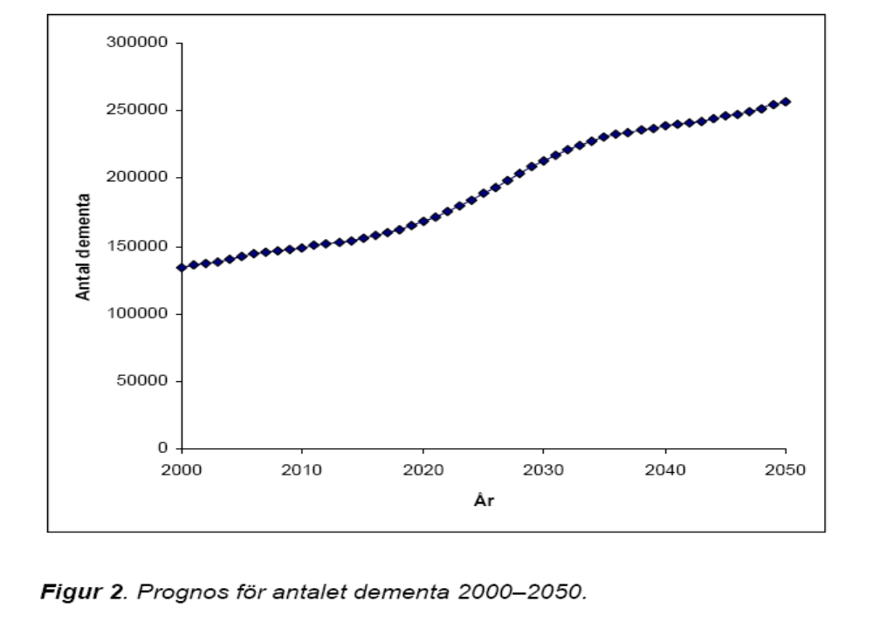
The number of persons with dementia increases in Sweden
(SBU 2005)

Slide 8
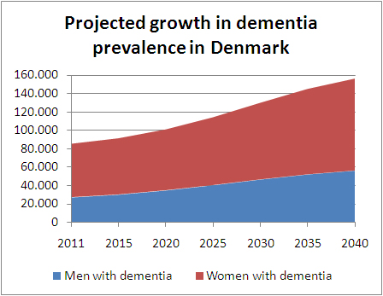
2011: 85 000
In Denmark dementia prevalece will increase by 50% at around year 2030

Slide 9
Dementia increases in the world
Rare before age 60
1% prevalence at age 65 year
Prevalence doubles every 5 year
Sweden:
2005: 140 000
2050: 250 000
Denmark
2011: 85 000
2050: 150 000
Worldwide:
2005: 24 millions
2040: 80 millions
(Socialstyrelsen 2005)
(Ferri et al, Lancet, 2005)

Slide 10
Dementia diseases most expensive group
Disease group
Cost
Billions SEK
Dementia
38,4
Reumatic diseases
36
Psykiatric diseases
36
Cancer
33
Depression
32,5
Heart diseases
25
Alcohol
20,3
Stroke
12
Diabetes
7
(SBU 2005)

Slide 11
Alzheimer´s disease most common cause of dementia
Alzheimer´s disease 60%
Vascular dementia 25%
Lewy body dementia 10%
Frontotemporal dementia 5%

Slide 12
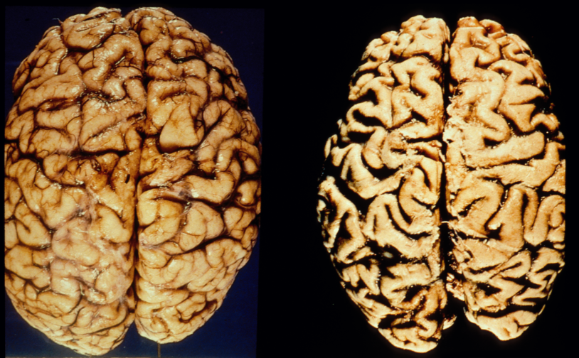
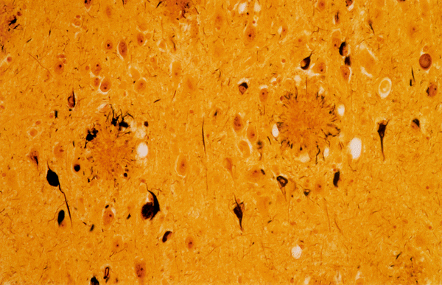
Abnormal protein aggregation causes AD
Control
Alzheimer
Amyloid plaques
(amyloid beta protein)
Alzheimer brain degenerates
Neurofibrillary
”tangles”
(tau-protein)
Amyloid plaques
Abnormal protein aggregation cuases brain dysfunction
Neurofibrillary tangles
Notes:
12

Slide 13
What is the beta-amyloid protein ?
Cell membrane
Amyloid β-protein = Aβ
Cleavage of cell membrane protein produces Aβ
Aß
Two main forms: Aβ1-40, Aβ1-42
Notes:
13

Slide 14
Aβ aggregates and forms plaques
Aβ
Notes:
14

Slide 15
Amyloid cascade hypothesis
Ageing
Genes
Life style
Unknown factors
Increased level of Aβ
Increased level of tau protein
Neuronal cell death
(Hardy et al., 1992)

Slide 16
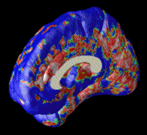
Neurodegeneration in Alzheimer patient´s brain
Thomson et al., J. Neurol. Science, January, 2011
Notes:
16

Slide 17
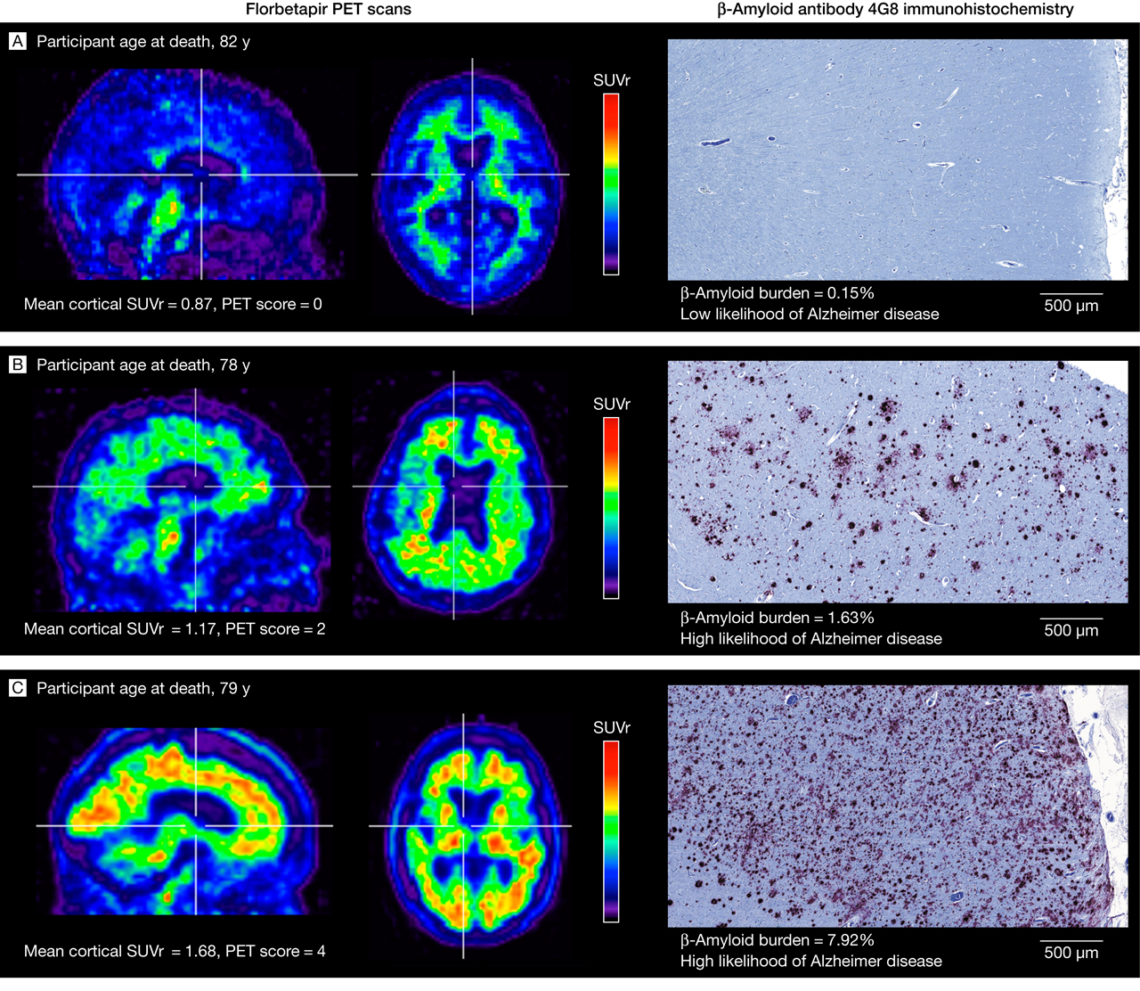

PET camera shows Aβ aggregation
Clark, C. M. et al. JAMA 2011;305:275-283
Copyright restrictions may apply.
Notes:
Sagittal and axial views of positron emission tomographic (PET) scans of representative patients. The vertical bars indicate the range of semiautomated quantitative analysis of the ratio of cortical to cerebellar signal (SUVr) scores. The maximum color (red) corresponds to an SUVr of approximately 2.2. The 4G8 immunohistochemistry shows precuneus gray matter with aggregated β-amyloid (red) using a 3-amino-9-ethyl-carbazol chromogen stain and counterstained with acid blue 129 (original magnification ×5).

Slide 18
Soluble Aβ is neurotoxic
Walsh et al., Nature, 2002
Notes:
18

Slide 19
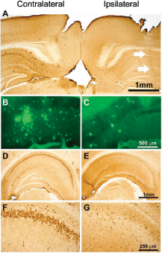
Vaccination reduces Aβ in the brain
Ej vaccin.
Vaccinerade
Oddo et al., Nature, 1999
Notes:
19

Slide 20
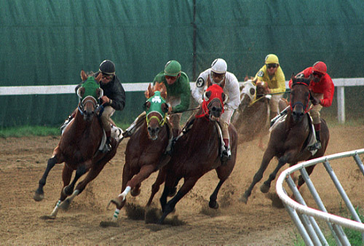
Race for first effective vaccine against AD
Notes:
20

Slide 21
Risk factors
Dementia in general Alzheimer
High age High age
Diabetes Genetic changes
Hypertension APOE ε4 gene
Hyperlipidemia Female gender
Obesitas Head trauma
Smokin

Slide 22
Symptoms depend on where neurodegeneration is located
Language
Initiative, Emotions, Attention
Insight
Empathy, Impulse control
Motor functions
Short term memory (Hippocampus)

Slide 23
Knowledge of the disease course is the key for consensus about the goals of care
MCI
Mild
Moderate
Severe dementia
Eating difficult
Inkontinence
Motoric dysfunc.
Dysfagia
Recurrent infections
Bedbound
Mutant
Level of functions
iADL-help
Dementia
Group
living
Totally dependent
5 – 20 year
Notes:
The progression to Dementia always begins with minor memory problems, Mild cognitive impairment, MCI which means that, even though you obiously have memory problems, the problems are not severe enough to cause any major difficulties in your daily living.
In the mild dementia phase you will have a more marked impairment of various cognitive functions so that instrumental activities of daily living are harder to perform, for example, pay bills, shopping, find your way to the shop, organize your life, take care of meetings and so on. But still you do not have any difficulties in taking care of your self and your own hygiene.
In the moderate dementia phase, however, you need help to take care of your personal hygiene. Very often this is the time point when living at home is not possible any longer.
The severe dementia phase is characterized by:
-Swallowing difficulties, dysfagia
-Recurrent infections, very often pneumonias because of aspiration,
-they will have motor dysfunction which in the end will make them bedbound (?).
- They can not communicate verbally
-you will find a person that is totally dependent on other care givers to maintain basic needs.
Interestingly, one can live months but also even a year or more in this last phase of dementia. Of course on an individual basis, even if you are sure that this is the end stage, I advice you not to say anything about how long time that is left because we always over- or underestimate the time left and relatives will be disappointed when your estimation of time left was incorrect.

Slide 24
Summary
Dementia increases all over the world
Dementia most expensive disease group
Pathology and clinical characteristics
Disease course 4 phases – signs of end stage dementia
Neurodegenerative diseases – similar in late phase
Cardinal signs of end stage/ late phase dementia

Slide 25
BPSD

Slide 26
Behavioural and psyciatric disturbances in dementia (BPSD)
Behavioural disturbances (=main problem for surrounding)
Aggressions
Irritability
Obstruction
Screaming
Restlessness
Walking
Sleeping disturbances
Inactivity
b. PSYCOTIC SYMPTOMS (=main problem for patient)
Depression
Anxiety
Rigidity
Notes:
Begreppet BPSD (Behavioural and Psychological Symptoms in Dementia) myntades 1996 som ett samlingsnamn för ett antal icke-kognitiva symtom vid demens. Förekomsten av BPSD är en av de viktigaste faktorerna som bestämmer livskvalitén och hur länge en demenssjuk person kan bo kvar hemma. Den första gruppen av symtom - beteendestörningar – står för det som omgivningen uppfattar av patientens sätt att hantera sjukdomen. Beteendestörningar är alltid något relativt. Ett och samma beteende kan vara problematiskt och föranleda insättande av psykofarmaka på ett trångt gruppboende med flera BPSD-patienter och personalbrist, men i en annan omgivning vara helt acceptabelt. Den andra gruppen av symtom – ’psykologiska symtom’ står för patientens stämningsläge och inre upplevelser, som nedstämdhet, onormal upprymdhet, oro, ångest, psykotiska vanföreställningar och hallucinationer.

Slide 27
Symptoms depend on where neurodegeneration is located
Language
Initiative, Emotions, Attention
Insight
Empathy, Impulse control
Motor functions
Short term memory (Hippocampus)

Slide 28
Neurodegeneration in crucial areas causes BPSD
Lack of perception ability
Lack of ability to interpret perceptions
Lack of emotional control
Lack of impulse control
Lack of insight

Slide 29
BPSD over time in Alzheimer´s disease
Depression
Aggression
Shouting
Hallucinations
Rigid thoughts
Early phase late phase
Notes:
De olika symtomen i BPSD-gruppen kan förstås på flera olika sätt. De kan tolkas som naturliga reaktioner hos en patient som kämpar med att försöka förstå en obegriplig omgivning , eller de kan ses som relaterade till graden och lokalisationen av hjärnskadan, eller till brist på olika signalämnen. Depressiva symtom är mycket vanligt i tidiga stadier och är relaterad till graden av sjukdomsinsikt. Aggressivitet beteende kan förstås som en naturligt beteende när förmågan till verbal kommunikation sviktar. Hallucinationer och vanföreställningar är i viss mån relaterade till nedsatt visuell perceptionsförmåga. Skrik och ropbeteende är typiskt för patienter med avancerad demens som är bundna till säng eller stol och som har tappat förmågan till annan kommunikation.

Slide 30

Communication difficulties causes BPSD
External stimuli, symptom or care plan (dressing, bathing, go to bed)
Staff try to help
Patient misperception situation (because of neurodegeneration cortex)
Patient misunderstands situation – danger?
Lack of ability to adjust resistence (amygdala+frontal cortex)
Strong resistence is interpreted by staff as aggression
Desire for drugs against aggression at the medical round

Slide 31
Symptom assessment of BPSD
1. What symptoms are observed?
- BPSD and other symptoms
2. When did it start?
3. What caused the symptoms to occur?
4. Variations througout the day (surroundings, milieu, staff approach)?
When calm? When BPSD?
5. Previous medical history?
6. Medical examination, somatic and psychiatric status
examine whole body; mouth, abdomen, articular examination, feet
7. Basic human needs addressed, physical and existential needs?
human contact, aktivity, nutrition, elimination, sleep
8. Inventory of drugs? Adequate pain control?
9. Interpretation of the situation
10. Action depends on the cause
11. Evaluation
12. Don´t treat difficulties in communication with drugs!!!

Slide 32
Haloperidol
3 studies
Some effect on aggression in doses >1,5mg/day
Insufficient data for effect with doses below 1,5mg/day
Marked extrapyramidal side effects
No studies on dementia
Not recommended in dementia

Slide 33
Risperidone
6 studies - 30-60% improvement - difference vs placebo non significant!
One study; Risperidone 1,2mg/dag effect on psycotic symptom in severe dementia but small effect compared with placebo
≥MMSE 13-15p, no difference between Risperidone vs placebo
Side effects
previous indication: unspecific states of anxiety/aggresion in dementia
Changed indication after metaanalys 2004 increased risk of intracerebral lesions (stroke eller TIA) in patients with Risperidone treatment
Current indication: Severe psychotic symptoms like aggressions in persons with dementia for whom such symptoms may lead to suffering, danger for the patient or risk of selfdestructive acts

Slide 34
Bensodiazepines
One study on Temesta:
- more effective than placebo
- remarkable risk of falling, impaired cognition och paradoxal reactions
Clinical experience:
- short acting BDZ like Sobril (Oxazepam) may be tested for anxiety
No evidence of effect in long term use
Risk of side effects, addiction or side effects after stopping medication
Think ”In and out dates”, in similarity with antibiotic treatment

Slide 35
Hemineurin (Klometiazol)
Accepted for sleeping disturbances and agitation in elderly
No studies on persons with dementia
Side effects
Clinical experience:
In hospitals and under careful observation Hemineuvrin may be used in acute situations

Slide 36
Pharmacological treatment of BPSD
Optimize pain and symptom control
Depressive symptoms - SSRI:s
Irritability, agitation or anxiety – SSRI:s
Memantin (Ebixa) may be tried on agitation och aggressivitet
If acute sedation needed: Sobril for short time and with adequate observation of the patient
Psycotic symptoms/aggression:
- Risperidone -1,5mg/day may be tested
- Restrictions because of risk of stroke and increased mortality
- initially maybe Sobril
If neuroleptics or anxiolytics:
- Short treatment duration – 2 weeks
- Clarify ”in and out” date!
- Evaluate
- Reconsider indication

Slide 37
Summary BPSD
Correlates to neuroanatomical changes
Miscommunication main reason
Pharmacological treatment no/little effect vs placebo
Non-pharmacological treatment 1:st choice
Don´t treat miscommunication with drugs!!

Slide 38
Kasper is a 86 year old gentlemen suffering from Alzheimer´s disease, living in a dementia group living. His two sons want to talk to you and make sure that you will; rescusitate if Kasper´s heart stops, refer Kasper to hospital if he gets an infection, they would also like to ask you you to put in a nasogastric tube because of his swallowing difficulties. What would you say to the sons?

Slide 39
ETHICAL ISSUES
Cardiopulmonary resuscitation
Hospital referral
Nutrition
Antibiotics

Slide 40
CPR – evidence in dementia
Immediate survival in dementia group living 18.5%
(Finucane et al 1999)
3.4% survived
(Finucane et al 1999)
Dementia: 1% survival
0-5% survival of patients recieving CPR
(Murphy et al NEJM, 1994)
Complications; fracures, sequeles, cognitive impairment
41% of relatives positive to HLR in dementia group living
5% positive after information about prognosis (0-5% in severe dementia)
(Murphy et al NEJM, 1994)

Slide 41
Referral to Hospital- evidence
18,7% mortality (6 week) in group livings
39.5% mortality if referred to hospital
Comparable groups
(Thompson et al 1997)
Confusion, falls, eating refusal, incontinence
Psychometrics, restrictions, nasogastric tubes, urinary catheter
Complication risk high
Prolonged time in hospital
Worse functional status 2 months after hospital admittance
Risky, impairs functions, increased mortality

Slide 42
Nutrition
Severe dementia – cannot eat themselves, difficulties to swallow
Refusal to eat is common
Adjust consistence of food
Eating refusal – symptom control, anti-depressants eller apetite stimulants
(Morris et al 2000)
Nasogastric tube does not affect survival
(Gillick et al NEJM 2000)
Nasogastric tube does not prevent aspiration pneumonia
Risk of complications
Risk of infections
Inconventient
Restrictions necessary?
Mortality associated with PEG
Malnutrition vs kakexi – malnutrition/hunger/reversible,
cachexia/no hunger/irreversible

Slide 43
Antibiotic treatment
Motivated in isolated infections
Oral treatment equally effective compared to intravenous administration
Patients - why needles? why blood samples? Restrictions? Psykotropics?
No effect on survival time in severe dementia
(Luchins et al 1997)
Analgetics och Antipyretics effective for symptom control
Complication risks – GI side effects, allergies, clostridium difficile infections
Recurrent infections limit the effect on survuval time
Which infection is ”ok” to be the last?

Slide 44
What can we expect?
High
Cancer
Heart failure, KOL, Multidiseased
Terminal
phase
Function level
Dementia
death
Low
Time
Notes:
The question what we can expect is central for us as physicians and for relatives. We make our medical decisions based on what is appropriate in different stages of the disease. For example, the decision about antibiotic treatment will be different for a person with Alzheimer´s disease living at home, compared to a person in the terminal phase of the disease.
The picture shows you the pattern of functional status decline over time in different uncurable disease groups. On the y-axis you have functional level and on the x-axis you have time.
As you can see, in cancer you will have a period of slow progression and then a quite fast functional decline during the late palliative phase.
In heart failure, chronic obstructive lung disease, or other multidiseased persons you will have a slow progression over a long period of time, mixed with short periods of severe, critical, exacerbations.
In Dementia you will have a prolonged disease progression over many years and we will also see fluctuations in the functional level caused by infections or other acute events.
The disease course in dementia will progress during anything between 5-20 years. If nothing acute happens, the rate will be quite constant. In fact, the best predictor of the disease progression at least in primary neurodegenerative diseases seem to be the rate of progression the year before. Because of the prolonged disease course and the fluctuations, it can be difficult to know if the patient is nearing the end of life stage
44

Slide 45
Knowledge of the disease course is the key for consensus about the goals of care
MCI
Mild
Moderate
Severe dementia
Eating difficult
Inkontinentia
Motoric difficult
Dysfagia
Recurrent infections
Bedbound
Mutant
Level of functions
Dementia
Group
living
Totally dependent
5 – 20 year
Notes:
The progression to Dementia always begins with minor memory problems, Mild cognitive impairment, MCI which means that, even though you obiously have memory problems, the problems are not severe enough to cause any major difficulties in your daily living.
In the mild dementia phase you will have a more marked impairment of various cognitive functions so that instrumental activities of daily living are harder to perform, for example, pay bills, shopping, find your way to the shop, organize your life, take care of meetings and so on. But still you do not have any difficulties in taking care of your self and your own hygiene.
In the moderate dementia phase, however, you need help to take care of your personal hygiene. Very often this is the time point when living at home is not possible any longer.
The severe dementia phase is characterized by:
-Swallowing difficulties, dysfagia
-Recurrent infections, very often pneumonias because of aspiration,
-they will have motor dysfunction which in the end will make them bedbound (?).
- They can not communicate verbally
-you will find a person that is totally dependent on other care givers to maintain basic needs.
Interestingly, one can live months but also even a year or more in this last phase of dementia. Of course on an individual basis, even if you are sure that this is the end stage, I advice you not to say anything about how long time that is left because we always over- or underestimate the time left and relatives will be disappointed when your estimation of time left was incorrect.

Slide 46


Advanced care planning is the key – Goals of care
Etical issues:
Expectations? Fears?
CPR?
Antibiotics?
Nutrition?
Referral to hospital?
What matters to patient/relatives?
Terminal phase
Notes:
We need to talk at an early stage to relatives about their expectations, their fears. We need to talk to relatives about what the disease progression will look like. Meeting relatives can also help us understand what is really important to them in the care of the patient as the patient can not tell us themselves.
From my clinical experience I know that some central ethical issues will arise when we are dealing with uncurable diseases like dementia. These issues are:
Cardiopulmonary resuscitation (CPR)?
Antibiotic treatment?
External nutritional support?
Referral to hospital?
It is important to address these issues at an early stage together with relatives before they occur in order to explain what we know about the potential effect of these different interventions. Later in the course you will work in groups in order to list key evidence on the effect of these interventions.
Advance care planning and to describe the disease course and to define in what stage of the disease course the patient is now, is really the key on order to obtain a broad consensus on the goals of care
My experience is that when I draw the functional status curve of a person with dementia and put a cross in the end of that line so that relatives get a chance to realise where in the disease course we are right now, relatives very often for the first will time understand how seriously ill the patient is and then they adjust their expectations for the future to more reasonable goals. [Kan vi ha kurvan från Advance care planning på sedan och markera med ett kryss?]
46

Slide 47
”Sundelöf´s Checklist for dialogue with relatives”
Describe disease course within 1 month after referral to dementia group living
Describe in advance the “signs” of end stage dementia
Mark in what phase of the disease the patient is
Talk about external nutrition/fluids in terminally ill patients
– risk of nausea and fluid retention
Describe cachexia vs malnutrition
Evidence
Cardiopulmonary rescusitation
Referral to hospital
Antibiotics
External nutritional support
Common causes of death in dementia – “recurrent infections”
Post mortem dialogue with relatives 4-6 weeks after death – feed back for free!
Notes:
Kan hoppas över om vi måste korta

Slide 48
Symptom control
Symptom prevention
Symptom assessment
Symptom treatment

Slide 49
Symtomprevention
Vanliga tillstånd
- förstoppning
- urinretention/inkontinens
- kroniska tillstånd
- infektioner
- aspiration
- falltendens – frakturrisk
- polyfarmaci
Fiberrik kost – motverka förstoppning
Frekventa vändningar – motverka trycksår och pneumoni
God munvård – motverka sväljningsbesvär
Fallprevention
Lm-sanering

Slide 50
Symptom prevention
Common complications
- obstipation
- urinary retention/incontinence
- cronical illnesses
- infections
- aspiration
- falling – risk for fractures
- polypharmaci
Fiber rich meals – prevent obstipation
Frequent position changes – prevent pressure ulcers and pneumonia
Ambitious mouth care – prevent swallowing difficulties
Prevention of falling
Review of pharmacological treatment
Rescue doses for pain, nausea, anxiety and secret stagnation

Slide 51
Symptom assessment
Lack of optimal assessment tools (some exist; Abbey Pain Scale for pain)
Changed behaviour (body language) may indicate bad symptom control
Identify the cause of changed behaviour or BPSD
Signs of pain?
Earlier pathology – medical record!
Examine the patient!
mouth, abdomen, articular examination, feet
Exclude obstipation, urinary retention, fracture, infection
Liberal use of analgetics
Evaluate

Slide 52
Symptom assessment – teamwork
Medical journal
Family, relatives, staff
Abbey Pain Scale
Documentation
Interpretation
Treatment - plan
Evaluation

Slide 53
Symptom control in end stage dementia
Optimize enviroment
Pain control
Mouth care
Prevent pressure ulcers
Plan for miction/defecation

Slide 54
Symptom control in end stage dementia
Optimize treatment for breathlessness – heart failure?
Rescue doses prescribed for pain, nausea, anxiety and secret stagnation
Advanced care planning at dementia home and hospital
Documentation updated
Liverpool Care Pathway (?)

Slide 55
Dementia– palliative philosophy is the solution
Symptom control
Team work
Support of relatives
Communication

Slide 56
Take home messages
Dementia increases rapidly because of aging population
Dementia most expensive disease group
Evidence of CPR, Antibiotics, Nutrition, ”Referral to hospital”
Don´t treat communication difficulties with drugs!
Changed behaviour – symptom control?
Abbey Pain Scale
Advanced care planning one of the keys!
Early description of disease course and end stage symptoms!
Checklist communication with relatives
Symptom prevention, symptom assessment, symptom control

Slide 57
Take home messages
Demens ökar i takt med att antalet äldre blir fler
Demenssjukdomar dyraste sjukdomsgruppen
4 faser i förloppet vid demenssjukdomar
Kardinalsymtom på slutfas vid demens
Evidens för HLR, Ab, Nutrition, ”Skicka in”
Behandla inte kommunikationsbrist med Lm!
Ändrat beteende – symtomkontroll?
Tidig vårdplanering är nyckeln
Beskriv sjukdomsförloppet i tid!
Checklista för kommunikation med anhöriga
1:a hjälpen i mötet med personer med demens
Symtomlindring, symtomskattning, symtomprevention
God vård i livets slut oavsett diagnos en mänsklig rättighet

Slide 58
Take home messages
Dementia increases globally with ageing population
Most expensive disease group
4 phases of dosease – cardinal signs of end stage dementia
Evidence CPR, Antibiotics, Nutrition, ”Hospital referral”
Don´t treat communication difficulties with drugs!
Changed behaviour – symptom control?
Advanced care planning is the key!
Describe disease course to relatives in time!
Checklist in communication with relatives
Symptom prevention, assessment and symptom control
Symptom control in the end of life a human right regardless of diagnosis

Slide 59
”A person who leaves life should recieve just as much attention and loving care, regardless of the diagnosis, as the care given to a person who just entered life,”
Thank you!

Slide 60

www.svensktdemenscentrum.se

Slide 61


Slide 62


Slide 63
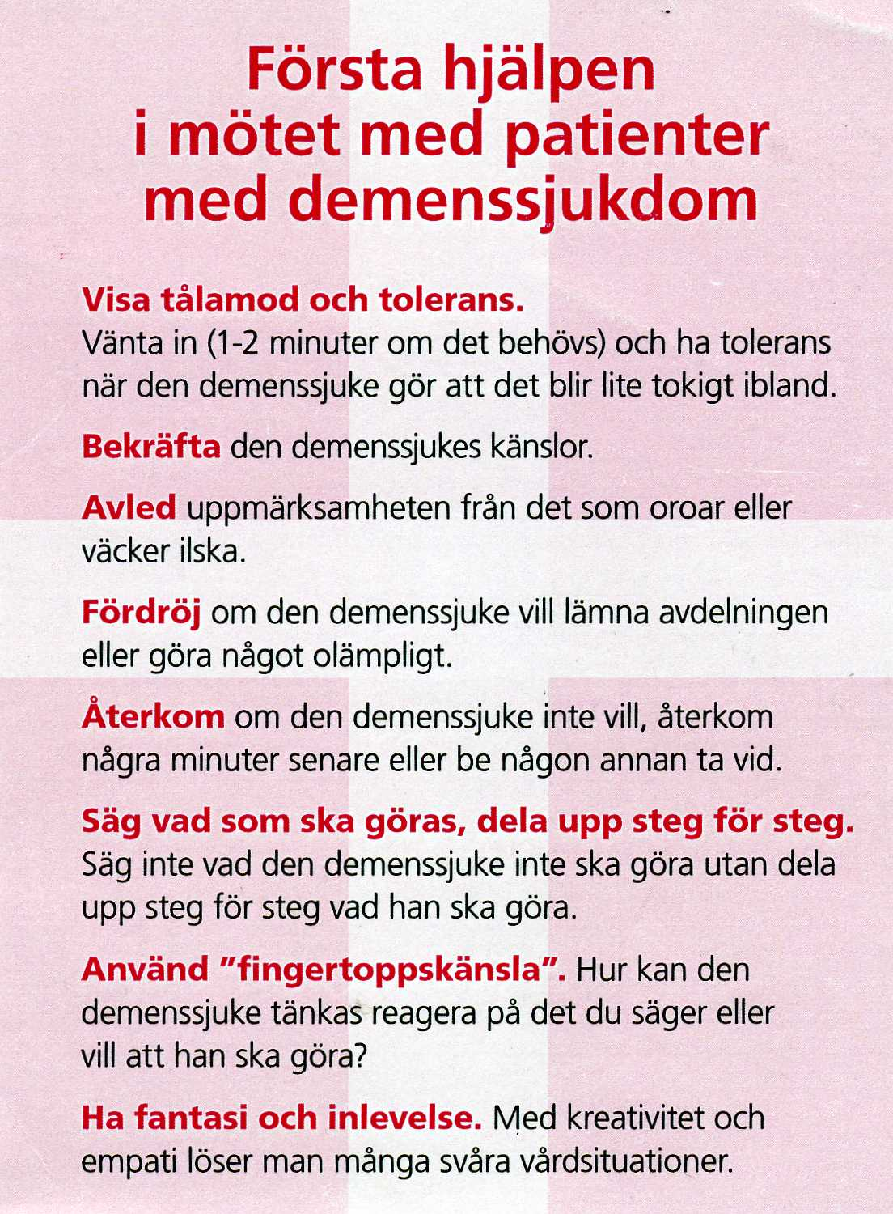

Slide 64
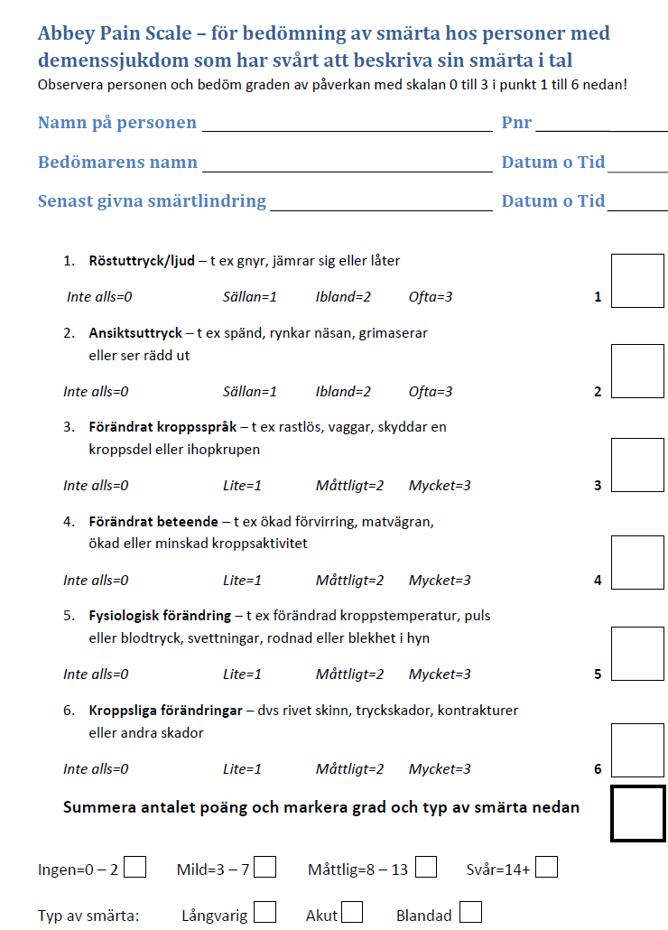

Slide 65
Reflections
In evenings weekends takes lång time for nurse to get rescue doses prescribed
Care in the dementia group livings best solution
Staff must know dementia – all professions
Blood transfusions?
Does the patient understand?
For who´s sake are we acting?
Swedish term ”kasta macka” – look further downstream
Avoid blaming each other
It takes two for a tango! Both primary care and hospitals need to help each other
Clarify the plan
If the physician does not have the time – help the nurse to be able to act – rescue doses!

Slide 66
Reflections
Economical support for avanced care planning
GP:s fully booked
Not only time, education!
What matters to patient, to relatives?
What are the goals of care?
Relatives help us decide, they mustn´t feel guilty for the decisions
High quality care – communication, high ambition in care, high ambition in prevent BPSD and prevent bad symptom control, optimize nutrition

Slide 67
Reflections
BPSD assessment
Symptom prevention
Basic insights in ethical issues
Advanced care planning – communication
Prescribe rescue doses
Once the situation occurs it is much harder
”beredskapsjourer” are not included in education programmes, limited interest in visiting patients and refers patients often
Minimum one nurse per ward?
Taxes, demographic development
Kalmar reduced emergency ward costs with 13% by advanced care planning and collaborations

Slide 68
Vård i livets slut vid demenssjukdom
21 november 2013
Östersund
Johan Sundelöf, MD, PhD
Överläkare Löwet ASIH, Upplands Väsby
Inst. för Folkhälso-/Vårdvetenskap, Uppsala Universitet
Johan.sundelof@pubcare.uu.se

Slide 69
”Upplägg”
Demenssjukdomar
BPSD
Evidens HLR, antibiotika, nutrition, ”skicka in”
Kunskap om sjukdomsförloppet är nyckeln
Symtomlindring
Demens ABCplus, Masterutbildning om demens

Slide 70
Take home messages
Demens ökar i takt med att antalet äldre blir fler
Demenssjukdomar dyraste sjukdomsgruppen
Evidens för HLR, Ab, Nutrition, ”Skicka in”
Behandla inte kommunikationsbrist med Lm!
Ändrat beteende – symtomkontroll?
Tidig vårdplanering är nyckeln
Beskriv sjukdomsförloppet i tid!
Checklista för kommunikation med anhöriga
1:a hjälpen i mötet med personer med demens
Symtomlindring, symtomskattning, symtomprevention
God vård i livets slut oavsett diagnos en mänsklig rättighet

Slide 71
Palliation och demens
Alla människor skall tillförsäkras en god palliativ vård oavsett sjukdom (SOU 2001:6)

Slide 72
Definition av demens
Demens definieras som en bestående minnesförsämring (>6 månader) som är så uttalad att den leder till svårigheter att klara sitt vardagliga liv
(ICD-10; World Health Organization’s 10th International Classification of Diseases
DSM-IV; Diagnostic and Statistical Manual of Mental Disorders IV )

Slide 73
Alzheimers sjukdom är vanligaste demenssjukdomen
Alzheimers sjukdom 60%
Vaskulär demens 25%
Lewy body demens 10%
Frontotemporal demens 5%

Slide 74
Antalet personer med demens i Sverige ökar
(SBU 2005)

Slide 75
Demens ökar i Sverige och världen
Ovanligt före 60 år
1% vid 65 år och fördubblas vart 5 år
Sverige:
2005: 140 000 demenssjuka
2050: 250 000 demenssjuka
Världen:
2005: 24 miljoner demenssjuka
2040: 80 miljoner demenssjuka
(Socialstyrelsen 2005)
(Ferri et al, Lancet, 2005)

Slide 76
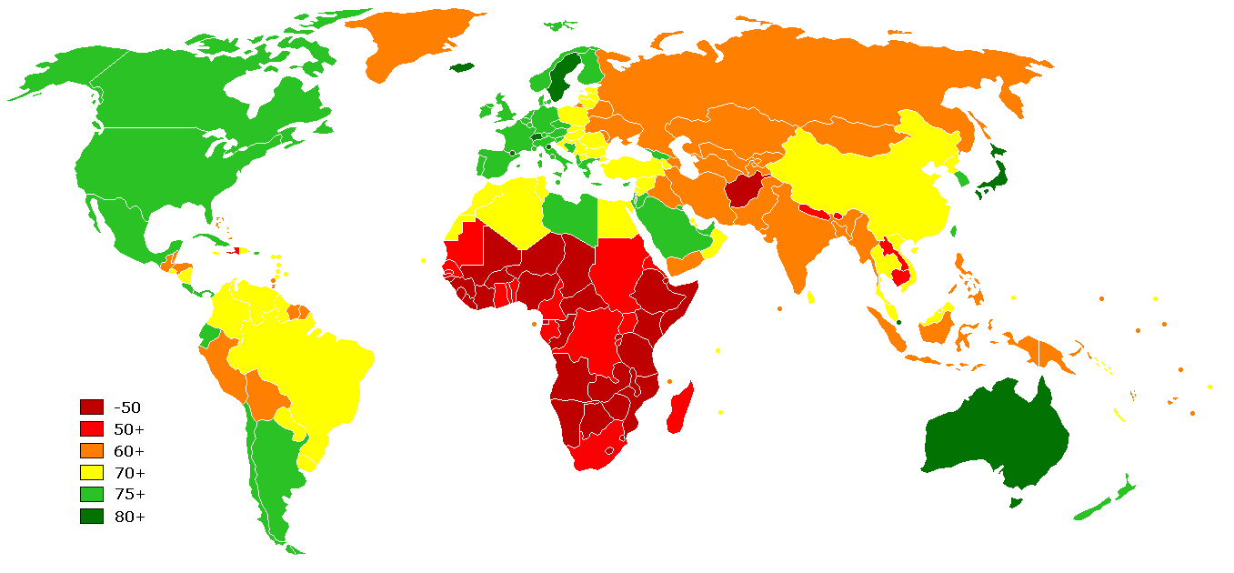
Andelen äldre ökar i stora delar av världen
(WHO 2012)

Slide 77
Demenssjukdomar kostar mest
Sjukdomsgrupp
Kostnad
(miljarder kr)
Demens
38,4
Reumatiska sjukdomar
36
Psykiska sjukdomar
36
Cancer
33
Depression
32,5
Hjärtkärlsjukdomar
25
Alkohol
20,3
Stroke
12
Diabetes
7
(SBU 2005)

Slide 78
Costs of dementia in denmarkDKK 77,000 per person per year. However, priority setting cannot be based on the cost of dementia per se, but only on the cost of a specific dementia intervention compared to its health benefit.

Slide 79
Onormal proteininlagring vid Alzheimers sjukdom
Kontroll
Alzheimer
Amyloida plack
(amyloid beta protein)
Alzheimer hjärnan degenererar
Neurofibrillära
Trådnystan
”tangles”
(tau-protein)
Amyloida plack
Onormal protein aggregering orsakar hjärndysfunktion
Neurofibrillära tangles
Notes:
79

Slide 80
Vad är ett beta-amyloid protein ?
Cellvägg
Amyloid β-protein = Aβ
Bildas när protein i cellväggen klyvs
Aß
Två huvudformer: Aβ1-40, Aβ1-42
Ökad mängd i ”plack” och blodkärl i hjärnan vid Alzheimers sjukdom
Notes:
80

Slide 81
Aβ aggregerar lätt och bildar plack
Aβ
Notes:
81

Slide 82
Amyloidkaskadhypotesen
Ålder
Genförändringar
Livsstilsfaktorer
Okända faktorer
Ökad mängd Aβ protein
Ökad mängd tau protein
Nervcellsdöd
(Hardy et al., 1992)

Slide 83
PET kamera visar Aβ inlagringar i hjärnan
Clark, C. M. et al. JAMA 2011;305:275-283
Copyright restrictions may apply.
Notes:
Sagittal and axial views of positron emission tomographic (PET) scans of representative patients. The vertical bars indicate the range of semiautomated quantitative analysis of the ratio of cortical to cerebellar signal (SUVr) scores. The maximum color (red) corresponds to an SUVr of approximately 2.2. The 4G8 immunohistochemistry shows precuneus gray matter with aggregated β-amyloid (red) using a 3-amino-9-ethyl-carbazol chromogen stain and counterstained with acid blue 129 (original magnification ×5).

Slide 84
Symtomen beror på var protein lagras in i hjärnan
Språk
Initiativförmåga, Känslor, Uppmärksamhet,
Sjukdomsinsikt
Empati, Impulskontroll
Motorik
Närminne

Slide 85
Kliniskt förlopp vid Alzheimers sjukdom
MCI
Mild demens
Måttlig
Svår
Ätsvårigheter
Inkontinens
Motorikstörn.
Närminne
Personlighet
Orientering
Funktions
nivå
Sväljningsbesvär
Återkommande
infektioner
Mutism?
Sängbunden?
Autonomi iADL-hjälp Annat boende Totalt beroende
pADL-hjälp
5 – 20 år

Slide 86
Knowledge of the disease course is the key for consensus about the goals of care
MCI
Mild
Moderate
Severe dementia
Eating difficult
Inkontinentia
Motoric difficult
Dysfagia
Recurrent infections
Bedbound
Mutant
Level of functions
iADL-help
Dementia
Group
living
Totally dependent
5 – 20 year
Notes:
The progression to Dementia always begins with minor memory problems, Mild cognitive impairment, MCI which means that, even though you obiously have memory problems, the problems are not severe enough to cause any major difficulties in your daily living.
In the mild dementia phase you will have a more marked impairment of various cognitive functions so that instrumental activities of daily living are harder to perform, for example, pay bills, shopping, find your way to the shop, organize your life, take care of meetings and so on. But still you do not have any difficulties in taking care of your self and your own hygiene.
In the moderate dementia phase, however, you need help to take care of your personal hygiene. Very often this is the time point when living at home is not possible any longer.
The severe dementia phase is characterized by:
-Swallowing difficulties, dysfagia
-Recurrent infections, very often pneumonias because of aspiration,
-they will have motor dysfunction which in the end will make them bedbound (?).
- They can not communicate verbally
-you will find a person that is totally dependent on other care givers to maintain basic needs.
Interestingly, one can live months but also even a year or more in this last phase of dementia. Of course on an individual basis, even if you are sure that this is the end stage, I advice you not to say anything about how long time that is left because we always over- or underestimate the time left and relatives will be disappointed when your estimation of time left was incorrect.

Slide 87
Kliniskt förlopp till svår demens
MCI
Mild demens
Måttlig
Svår
Ätsvårigheter
Inkontinens
Motorikstörn.
Närminne
Personlighet
Orientering
Funktions
nivå
Sväljningsbesvär
Återkommande
infektioner
Mutism?
Sängbunden?
Autonomi iADL-hjälp Annat boende Totalt beroende
pADL-hjälp
5 – 20 år

Slide 88
Sammanfattning
Demens ökar i hela världen – andel äldre fler
Demens dyraste sjukdomsgruppen
Patogenes olika demenssjukdomar
Klinisk bild – tidig och sen fas
Sjukdomsförlopp i 4 faser
Demenssjukdomar ”olika i början – lika i sen fas”
Kardinalsymtom demenssjukdom i slutfas

Slide 89
Beteendestörningar och psykiska symtom vid demenssjukdom (BPSD)
BETEENDESTÖRNINGAR (=huvudproblem för omgivningen)
Aggressivitet
Irritabilitet
Motsträvighet
Skrik
Rastlöshet
Plockighet
Opassande socialt beteende
Vandring, skuggning
Sömnsstörningar
Inaktivitet
b. PSYKISKA SYMTOM (=huvudproblem för patienten)
Depression
Oro
Ångest, hallucinationer och vanföreställningar
Notes:
Begreppet BPSD (Behavioural and Psychological Symptoms in Dementia) myntades 1996 som ett samlingsnamn för ett antal icke-kognitiva symtom vid demens. Förekomsten av BPSD är en av de viktigaste faktorerna som bestämmer livskvalitén och hur länge en demenssjuk person kan bo kvar hemma. Den första gruppen av symtom - beteendestörningar – står för det som omgivningen uppfattar av patientens sätt att hantera sjukdomen. Beteendestörningar är alltid något relativt. Ett och samma beteende kan vara problematiskt och föranleda insättande av psykofarmaka på ett trångt gruppboende med flera BPSD-patienter och personalbrist, men i en annan omgivning vara helt acceptabelt. Den andra gruppen av symtom – ’psykologiska symtom’ står för patientens stämningsläge och inre upplevelser, som nedstämdhet, onormal upprymdhet, oro, ångest, psykotiska vanföreställningar och hallucinationer.

Slide 90
Symtomen beror på var protein lagras in i hjärnan
Språk
Initiativförmåga, Känslor, Uppmärksamhet,
Sjukdomsinsikt
Empati, Impulskontroll
Motorik
Närminne

Slide 91
BPSD över tid vid Alzheimers sjukdom
Depression
Aggressivitet
Skrik och rop
Vanföreställningar,
hallucinationer
tidig fas sen fas
Notes:
De olika symtomen i BPSD-gruppen kan förstås på flera olika sätt. De kan tolkas som naturliga reaktioner hos en patient som kämpar med att försöka förstå en obegriplig omgivning , eller de kan ses som relaterade till graden och lokalisationen av hjärnskadan, eller till brist på olika signalämnen. Depressiva symtom är mycket vanligt i tidiga stadier och är relaterad till graden av sjukdomsinsikt. Aggressivitet beteende kan förstås som en naturligt beteende när förmågan till verbal kommunikation sviktar. Hallucinationer och vanföreställningar är i viss mån relaterade till nedsatt visuell perceptionsförmåga. Skrik och ropbeteende är typiskt för patienter med avancerad demens som är bundna till säng eller stol och som har tappat förmågan till annan kommunikation.

Slide 92
Orsak till BPSD
Bristande perceptionsförmåga
Bristande tolkningsförmåga
Bristande känslokontroll
Bristande impulskontroll
Bristande insikt

Slide 93
Kommunikationssvårigheter orsakar BPSD
Symtom eller omvårdnadsåtgärd (klä sig, bada, lägga sig)
Vårdpersonal försöker hjälpa
Patienten kan inte tolka situationen (pga skador i cortex)
Patienten uppfattar försök till hjälp som livsfara
Avsaknad förmåga att nyansera motstånd (skador amygdala+frontala cortex)
Kraftigt motstånd från patient tolkas som aggressivitet
Krav på lugnande medicin!!!

Slide 94
Symtomskattning vid BPSD
1. Vilka symtom föreligger?
BPSD och andra symtom som smärta, illamående, andnöd mm
2. När började symtomen?
3. Vad utlöste symtomen?
4. Dygnsvariation (omgivning, miljö, bemötande)?
När bra? När inte bra?
5. Tidigare sjukhistoria?
6. Medicinsk bedömning, fysiskt och psykiskt status
undersök hela kroppen; mun, mage, leder fötter
7. Basala mänskliga behov tillgodosedda?
Närhet, aktivitet, nutrition, mag-tarmfunktion, vattenkastning, sömn,
8. Läkemedelssanering? Adekvat smärtlindring?
9. Bedömning
10. Orsaksinriktad åtgärd
11. Utvärdera
12. Behandla inte kommunikationsbrist med läkemedel!

Slide 95
Arbetsstruktur vid beteendestörning
Beteende
Analys
Bedömning
Åtgärd
Utvärdering
Dokumentera!

Slide 96
Behandling vid BPSD
Viktigt att förstå bakgrunden – symtomkontroll?
Starkt evidens initiala interventioner av icke-farmakologisk art
Behandla inte kommunikationsbrist med Läkemedel!

Slide 97
Icke-farmakologisk behandling vid BPSD
Anpassa miljö och bemötande
Identifiera och åtgärda störande faktorer:
smärta, förstoppning, urinretention, fraktur, privat sfär bruten - detektivarbete
Flexibilitet i omvårdnad
Allt är inte läkemedel!
massage, vårdarsång, musikterapi, djurterapi
svårt att värdera – kan prövas (låg evidens)

Slide 100
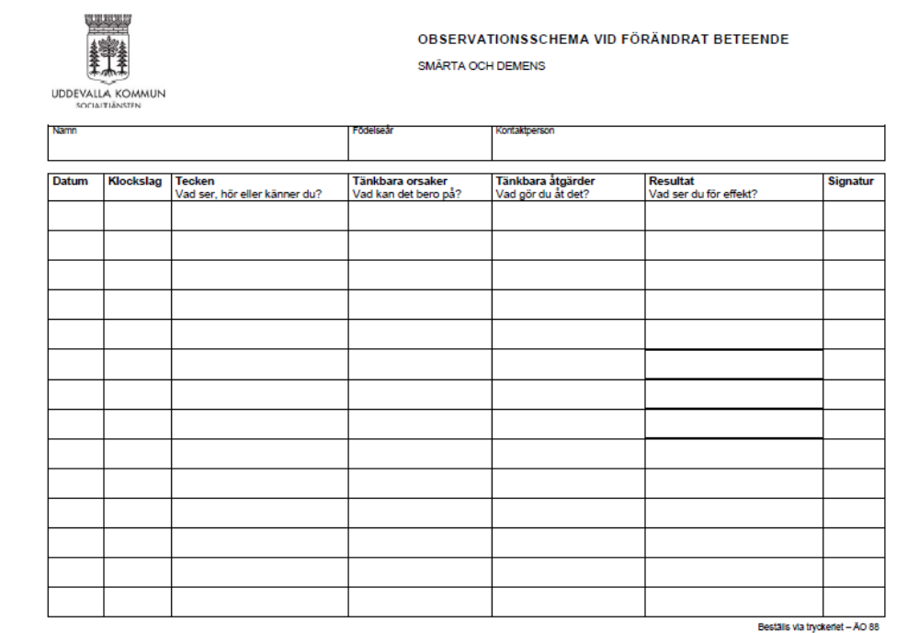

Slide 101
Farmakologisk behandling vid BPSD

Slide 102
Haldol
3 studier
Viss effekt mot aggressivitet i doser över 1,5mg/dag
Otillröcklig med data för effekt av doser under 1,5mg/dag
Extrapyramidala biverkningar begränsar nyttan
Demens ej studerat, rekommenderas ej

Slide 103
Risperdal
6 studier - 30-60% förbättras - skillnad mot placebo inte signifikant!
En studie; Risperdal 1,2mg/dag effekt på psykotiska symtom vid svår demens men effekt liten jämfört med placebo (uttalad demens och svåra symtom)
≥MMT 13-15 ingen skillnad mellan Risperdal och placebo
Extrapyramidala biverkningar
tidigare indikation: ospecifika orostillstånd vid demens
ändrad indikation efter metaanalys 2004 ökad risk för cerebrovaskulära händelser (stroke eller TIA) bland Risperdalbeh. patienter
Aktuell indikation: uttalade psykotiska symtom som aggressivitet hos personer med demens hos vilka sådana störningar kan leda till patientlidande, potentiell fara för patienten eller risk för självskada

Slide 104
Bensodiazepiner
en studie på Temesta:
- effektivare än placebo
- betydande fallrisk, nedsatt kognition och paradoxala reaktioner
Klinisk erfarenhet:
- kortverkande BDZ som Sobril kan prövas vid oro/ångest
Inga hållpunkter för positiva effekter vid långtidsanvändning
Risk för beroende och utsättningsfenomen
In- och utdatum

Slide 105
Heminevrin
Godkänt för sömnstörning och agitation på äldre
Inga studier på personer med demens
Biverkningsrisk
klinisk erfarenhet:
I slutenvård och under strikt kontroll kan Hemineuvrin prövas i akuta situationer

Slide 106
Icke rekommenderbara läkemedel vid BPSD
Acetylcholinesterashämmare: BPSD ej studerat, rekommenderas ej
Zyprexa och Seroquel inte övertygande visat, många negativa studier, rekommenderas ej
Nozinan: kraftig sederande effekt, rekommenderas ej
Haldol:
demens ej studerat
X-pyr biverkningar
effekt på aggressivitet >1,5mg/dag
senare studier talar för samma neg effekt på CVS och mortalitet som 2:a generation antipsykotika
rekommenderas ej
Antiepileptika
Karbamazepin viss effekt i pilotstudier men interaktions- och biverkningsrisk
rekommenderas ej

Slide 107
Farmakologisk behandling BPSD
Optimera smärtlindring
Depressiva symtom - SSRI
Irritabilitet, agitation eller oro - SSRI kan prövas
Memantin (Ebixa) kan ha effekt på agitation och aggressivitet
Om behov av akut sedation: Sobril ev. prövas under kort tid och med adekvat övervakning av patienten
Psykotiska symtom/aggressivitet som orsakar lidande för patienten och/eller potentiell fara för patient eller andra:
- Risperdal upp till 1,5mg/dag kan prövas
- Restriktivt användande pga risk för stroke och ökad dödlighet
Om neuroleptika eller anxiolytika:
- kort behandlingstid – 2 veckor
- precis som för antibiotika - tydligt start och slutdatum!
- utvärdering
- Ställningstagande till utsättning/dos regelbundet

Slide 108
Sammanfattning BPSD
Orsaken ofta kommunikationssvårigheter
Förklaras av neuroanatomiska skador
Korrelerar över tid till neuroanatomi
Lm liten/ingen skillnad mot placebo
Icke-farmakologiska åtgärder först
Behandla inte kommunikationssvårigheter med läkemedel!

Slide 109
ETISKA FRÅGOR
Hjärt-/lungräddning
Inremittering till sjukhus
Nutrition
Antibiotika

Slide 110
HLR – evidens vid demens
Omedelbar överlevnad särskilt boende 18.5% (Finucane et al 1999)
3.4% skrivs ut levande från sjukhus
(Finucane et al 1999)
Demens: 1% skrivs ut levande från sjukhus
0-5% av pat som fått lyckad HLR överlever (Murphy et al NEJM, 1994)
Komplikationer; frakturer, sekvele
Sämre kognitivt
41% positiva till HLR på ssk boende
5% positiva när prognos 0-5% vid svår demenssjukdom redovisades
(Murphy et al 1994)

Slide 111
Inremittering till sjukhus - evidens
18,7% Mortalitet (6 veckors) på boende
39.5% mortalitet vid inremittering till sjukhus
Jämförbara grupper
(Thompson et al 1997)
Konfusion, fall, matvägran, inkontinens
Psykometrika, restriktioner, sond, KAD
Komplikationsrisk
Förlängd vårdtid
Sämre funktionsstatus 2 månader efter sjukhusvistelse
Riskfyllt, försämrar funktioner, ökar dödligheten

Slide 112
Nutrition
Svår demens kan inte äta själva - sväljningsbesvär
Sätter i halsen, svårt att dricka
Matvägran vanligt
Anpassa matkonsistensen – tjockflytande, näringsdrycker
Matvägran - antidepressiva eller aptitstimulantia kan ev prövas
(Morris et al 2000)
Sond ingen effekt på överlevnad
(Gillick et al NEJM 2000)
Sond förhindrar inte aspirationspneumoni
Komplikationsrisk
Ökad infektionsrisk
Obehag
Restriktioner för att förhindra att sond dras bort
Mortalitet vid inläggande av PEG
Malnutrition vs kakexi – malnutrition/hunger/reversibelt,
kakexi/ej hunger/ej reversibelt

Slide 113
Antibiotikabehandling
Motiverat vid isolerad infektion
Peroral behandling minst lika effektiv som iv behandling
Patienter förstår inte - varför nål/odlingar?
Begränsas för genomföra behandling? Psykotropa Lm?
Förlänger inte överlevnad vid svår demens
(Luchins et al 1997)
Analgetika och Antipyretika lika effektiv symtomlindring
Komplikationsrisk – GI biverkningar, allergier, clostridier
Återkommande infektioner begränsar nyttan
Vilken infektion får vara den sista?

Slide 114
Läkarsällskapets etiska riktlinjer
1. Om en patient är beslutskapabel, välinformerad och införstådd med konsekvenserna av olika behandlingsalternativ ska läkaren respektera patientens önskan om att livsuppehållande behandling inte inleds och att redan inledd behandling avslutas. Detta gäller även i situationer då patienten inte befinner sig i livets slutskede och där behandling medicinskt sett skulle kunna gagna patienten. Läkare ska alltid erbjuda adekvat palliativ behandling.
2. Om en patient inte längre är beslutskapabel och fortsatt behandling inte gagnar patienten bör man respektera patientens tidigare uttryckta önskan om att avstå från att påbörja eller avbryta livsuppehållande behandling.
3. Om en patient inte är beslutskapabel och det inte finns muntliga eller skriftliga direktiv om patientens önskan, bör läkaren om möjligt samråda med de närstående och försöka ta reda på vad patienten skulle ha önskat om han eller hon varit beslutskapabel. Läkaren bör ta med detta i bedömningen av om man ska avstå från att inleda, begränsa eller avbryta livsuppehållande behandling och i dessa fall informera de närstående om olika behandlingsalternativ. Läkaren har det slutgiltiga ansvaret för beslutet att avstå från att inleda eller avbryta behandling.

Slide 115
Läkarsällskapets etiska riktlinjer
6. Då man är osäker på om en potentiellt livsuppehållande behandling kan gagna patienten är det angeläget att man så tidigt som möjligt samråder med patient och/eller närstående om att prognosen är oviss och att behandlingen kan komma att avbrytas om den visar sig inte gagna patienten.
7. När prognosen är oviss är det viktigt att inleda livsuppehållande behandling och sedan avbryta denna om den visar sig inte gagna patienten. Det är inte etiskt försvarbart att avstå från att inleda behandling om prognosen är oviss med hänvisning till att det är svårt att avbryta en redan inledd behandling.
8. I samband med avslutande av en livsuppehållande behandling måste man se till att patienten erbjuds adekvat palliativ vård, oavsett om patienten befinner sig i livets slutskede eller önskar avsluta livsuppehållande behandling av en kronisk sjukdom.

Slide 116
Vad kan vi förvänta oss?
Hög
Cancer
Hjärtsvikt, KOL, Multisjuklighet
Terminal
fas
Funktionsnivå
Demens
Död
Låg
Tid
Notes:
The question what we can expect is central for us as physicians and for relatives. We make our medical decisions based on what is appropriate in different stages of the disease. For example, the decision about antibiotic treatment will be different for a person with Alzheimer´s disease living at home, compared to a person in the terminal phase of the disease.
The picture shows you the pattern of functional status decline over time in different uncurable disease groups. On the y-axis you have functional level and on the x-axis you have time.
As you can see, in cancer you will have a period of slow progression and then a quite fast functional decline during the late palliative phase.
In heart failure, chronic obstructive lung disease, or other multidiseased persons you will have a slow progression over a long period of time, mixed with short periods of severe, critical, exacerbations.
In Dementia you will have a prolonged disease progression over many years and we will also see fluctuations in the functional level caused by infections or other acute events.
The disease course in dementia will progress during anything between 5-20 years. If nothing acute happens, the rate will be quite constant. In fact, the best predictor of the disease progression at least in primary neurodegenerative diseases seem to be the rate of progression the year before. Because of the prolonged disease course and the fluctuations, it can be difficult to know if the patient is nearing the end of life stage
116

Slide 117
Vårdplanering är lösningen – målet med vården
Etiska frågeställningar:
Förväntningar? Farhågor?
Hjärt-/Lungräddning?
Antibiotika?
Nutrition?
Inremittering till sjukhus?
Terminal fas
Notes:
We need to talk at an early stage to relatives about their expectations, their fears. We need to talk to relatives about what the disease progression will look like. Meeting relatives can also help us understand what is really important to them in the care of the patient as the patient can not tell us themselves.
From my clinical experience I know that some central ethical issues will arise when we are dealing with uncurable diseases like dementia. These issues are:
Cardiopulmonary resuscitation (CPR)?
Antibiotic treatment?
External nutritional support?
Referral to hospital?
It is important to address these issues at an early stage together with relatives before they occur in order to explain what we know about the potential effect of these different interventions. Later in the course you will work in groups in order to list key evidence on the effect of these interventions.
Advance care planning and to describe the disease course and to define in what stage of the disease course the patient is now, is really the key on order to obtain a broad consensus on the goals of care
My experience is that when I draw the functional status curve of a person with dementia and put a cross in the end of that line so that relatives get a chance to realise where in the disease course we are right now, relatives very often for the first will time understand how seriously ill the patient is and then they adjust their expectations for the future to more reasonable goals. [Kan vi ha kurvan från Advance care planning på sedan och markera med ett kryss?]
117

Slide 118
Kunskap om förloppet vid demens är nyckeln
till förståelse för målet med vården
MCI
Mild
Måttlig
Svår demens
Ätsvårigheter
Inkontinens
Motorik störd
Dysfagi
Återkommande infektioner
Sängbunden
Tyst
Funktionsnivå
Demensboende
Helt hjälpberoende
5 – 20 år
Notes:
The progression to Dementia always begins with minor memory problems, Mild cognitive impairment, MCI which means that, even though you obiously have memory problems, the problems are not severe enough to cause any major difficulties in your daily living.
In the mild dementia phase you will have a more marked impairment of various cognitive functions so that instrumental activities of daily living are harder to perform, for example, pay bills, shopping, find your way to the shop, organize your life, take care of meetings and so on. But still you do not have any difficulties in taking care of your self and your own hygiene.
In the moderate dementia phase, however, you need help to take care of your personal hygiene. Very often this is the time point when living at home is not possible any longer.
The severe dementia phase is characterized by:
-Swallowing difficulties, dysfagia
-Recurrent infections, very often pneumonias because of aspiration,
-they will have motor dysfunction which in the end will make them bedbound (?).
- They can not communicate verbally
-you will find a person that is totally dependent on other care givers to maintain basic needs.
Interestingly, one can live months but also even a year or more in this last phase of dementia. Of course on an individual basis, even if you are sure that this is the end stage, I advice you not to say anything about how long time that is left because we always over- or underestimate the time left and relatives will be disappointed when your estimation of time left was incorrect.

Slide 119
Vård i livets slut vid demens
Tidig information om sjukdomsförloppet
Tidig etisk diskussion om ”mål med vården”
Information och stöd till personal och anhöriga
Fortlöpande information om läget
Efterlevandesamtal 4-6 veckor efter dödsfall – källa till kunskap

Slide 120
Symtomlindring

Slide 121
Symtomkontroll
Symtomprevention
Symtomskattning
Symtomlindring

Slide 122
Symtomskattning
Bra skattningsverktyg saknas
Det ändrade beteendet varningsklocka
Sök bakomliggande orsak
Tecken på smärta?
Läs på om tidigare sjukdom i journalen!
Undersök hela kroppen
mun, mage, leder, fötter mm
Uteslut förstoppning, urinstämma, fraktur, infektion
Liberal med analgetika, utvärdera

Slide 123
Symtomskattning – ett lagarbete
Medicinsk journal
Familj, anhöriga och personal
Dokumentation
Tolkning
Behandling – åtgärd
Utvärdering

Slide 124
SMÄRTSKATTNING VID SVÅR DEMENS
ca 200 skattningsverktyg
Ingen riktigt bra vid svår demens
Självskattningsskalor
Observationsskalor
Rosenhälls demensboende – Uddevallaprojektet (svensk modell)
Engelska; MOBID, NOPPAIN, PACLAC, PAINAD, PAINE, Discomfort Scale, Abbey Pain Scale
Ändrat beteende – tänk smärta eller dålig symtomkontroll
Anhöriga viktig källa
Medicinsk journal – tidigare sjukdomar styr misstanke
Medicinsk undersökning – undersök hela kroppen; mun, mage, leder, fötter…
Tecknen på smärta:
Ansiktsuttryck, drar ihop ansiktet, rynkar pannan, snörper sina läppar, skelar, rullar med ögonen, grimaser, högröd ansiktsfärg, öppen mun, mumla, jämra sig, gnissla tänder, avslappnad eller spänd i ansiktet, masserar över öm kroppsdel, agitation, rastlös, irriterad, oro, vandrande

Slide 125
Abbey Pain Scale vid demens

Slide 127
Behandling av smärta vid demens
Åtgärda bakomliggande orsak om möjligt
Behandla smärtan parallellt
Traditionell farmakologisk behandling
Utvärdera fortlöpande
Ännu saknas optimalt skattningsverktyg för smärta vid svår demens
Abbey Pain Scale

Slide 128
Symtomkontroll
Teamwork
Strukturerad symtomskattning
Fysiskt status
Information till anhöriga
Palliativ vård

