Slide 1

Iatrogen opioid afhængighed
Per Sjøgren, Palliativt Afsnit, Onkologisk Klinik, Rigshospitalet, Januar 2019

Slide 2
WHO ANALGESIC LADDER
(1996)
STEP III OPIOIDS
Opioids for moderate to severe pain
+/- NSAID
+/- Adjuvant
STEP II OPIOIDS
Opioids for mild to moderate pain
+/- NSAID
Pain persists
or increases
+/- Adjuvant
NSAID
Pain persists
or increases
+/- Adjuvant

Slide 3
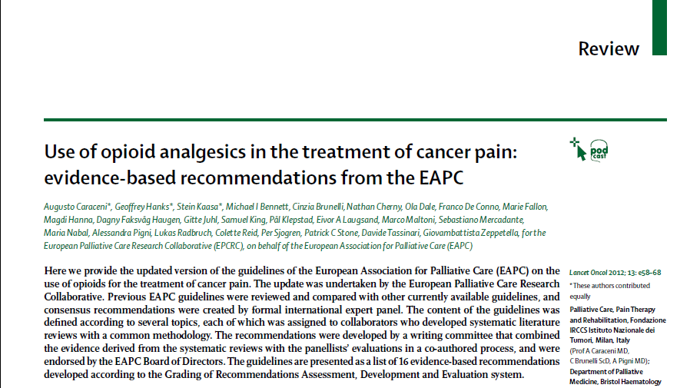

Slide 4
WHO analgesic ladder: a good concept gone astray
Ballantyne and Kalso, BMJ 2016
  “The success of opioid treatment in terminally ill cancer patients set the stage for extending the same moral
  imperative and treatment principles to the treatment of chronic pain, where previously opioids were
  considered too risky or not effective”
  “Over the past 30 years, in much of the developed world, we have seen more patients treated with opioids
  at higher doses than ever before. The extent to which the more liberal use of opioids would cause harm was
  not predicted”.

Slide 5
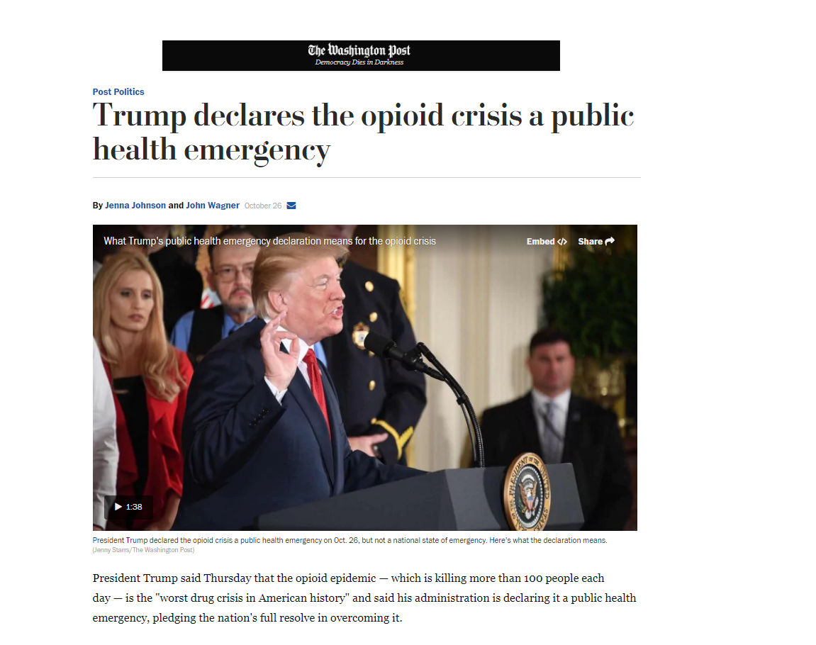

Slide 6
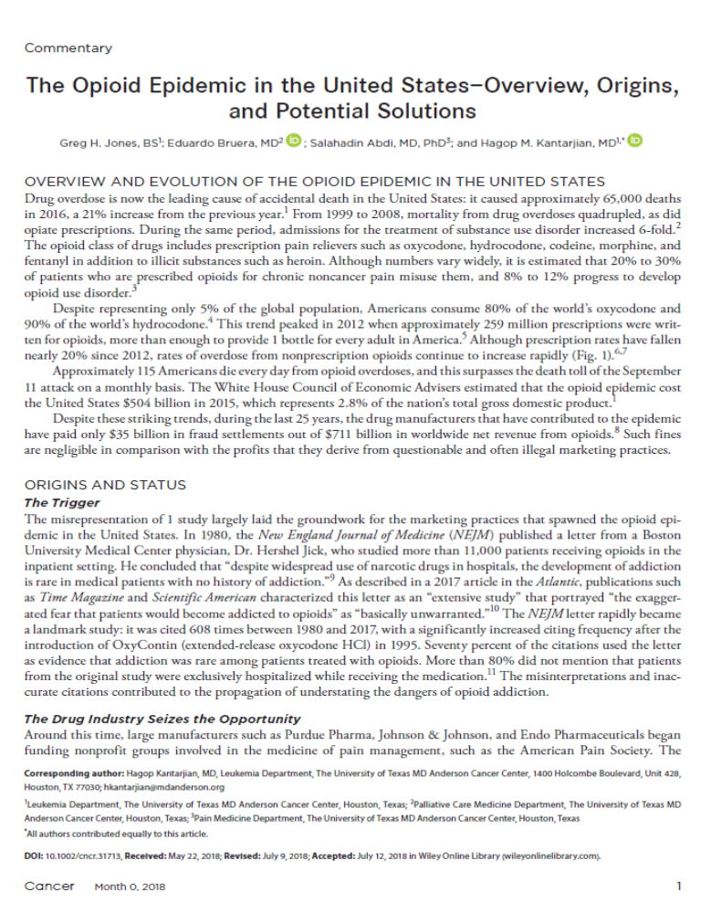
The opioid epidemic in United States
  Approximately 65,000 opioid-related deaths in 2016, a 21% increase from the previous year
  A 4-fold increase in US opioid-related deaths 1999-2010 associated with a 4-fold increase in opioid prescriptions 1999-2010
  In the same period, admissions for the treatment of substance use disorder increased 6-fold
  The opioid epidemic cost the United States $504 billion in 2015, which represents 2.8% of the nation’s total gross domestic product
  The drug manufacturers have paid only $35 billion in fraud settlements out of $711 billion in worldwide net revenue

Slide 7
Identification of the US opioid crisis
    Prospective population-based studies have:
    provided the warnings of opioid-related abuse (> 20%) and deaths in the US
    demonstrated that the long-term analgesic and health effects of opioid therapy are poor
    due to
      lenght of studies
      mixed population groups
      variations in practice
      open environment
  Paulozzi et al. Pain Med. 2012; Gomes et al., Arch Intern Med 2011; Dunn et al., Ann Intern Med 2010; Bohnert et al., JAMA 2011; Højsted et al., Pain 2013; Boscarino et al., J Addict Dis 2011.

Slide 8
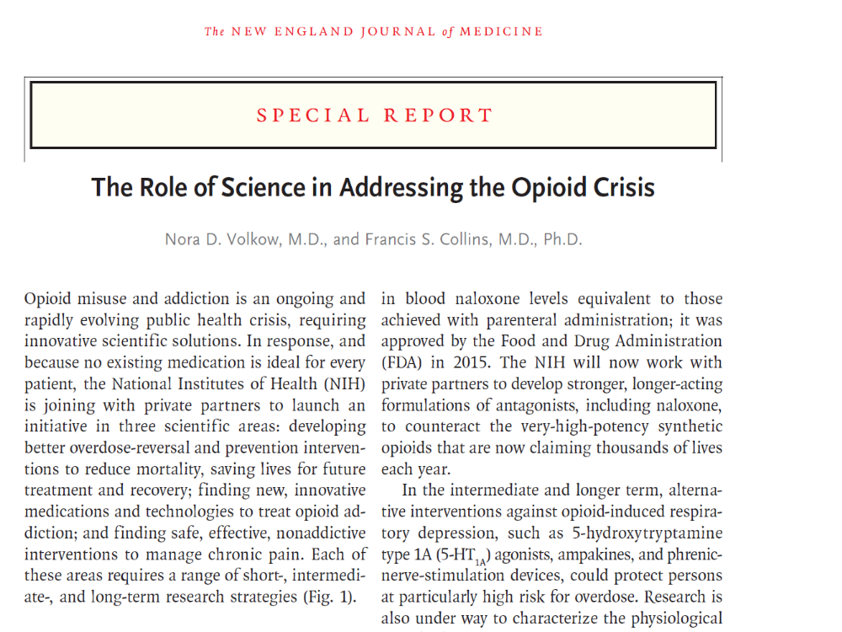

Slide 9
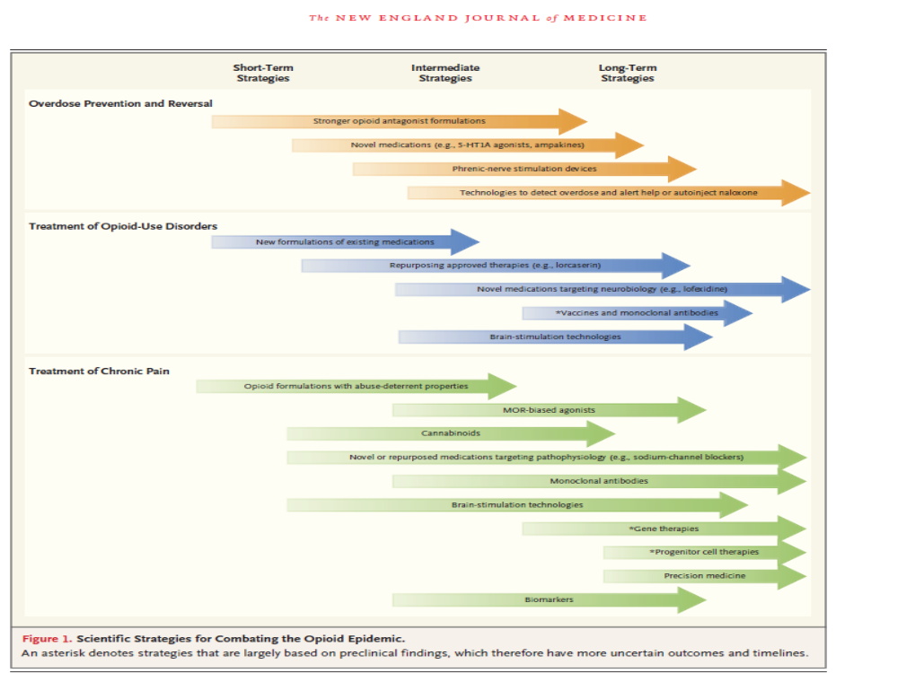

Slide 10
Opioid consumption: Why Denmark?
One of the highest per capita comsumption of prescribed opioids in the world
Many countries are moving in the same direction
Comprehensive and accurate healthcare statistics and databases
Not constrained by unmonitored private sector or by privacy sensibilities

Slide 11
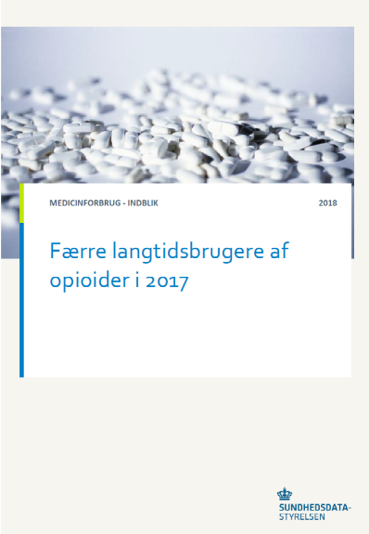
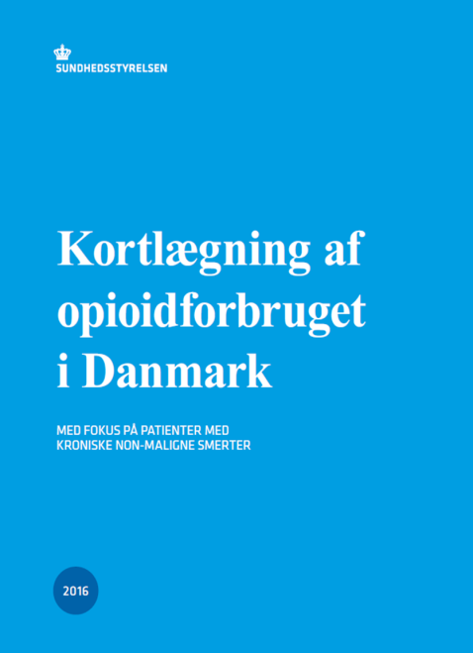
Estimate of opioid users and consumption in Denmark
Based ond three databases:
Numbers of users:
Acute pain: 55%
Cancer Pain: 13%
CNCP: 32%
Consumption:
Acute pain: 1%
Cancer pain: 30%
CNCP: 69%
The Board of Health estimated that 170.000 CNCP patients used opioids regularly (more than one prescription in 6 months) in 2017.
A decline of 14.000 since 2015 has been noted.
Højsted and Sjøgren, Curr Opin Anaesthesiol 2007
Jarlbaek et al., Ugeskr Læg 2010; The Board of Health Opioid Report 2016

Slide 12
The Danish Health and Morbidity Surveys
  The Danish Health and Morbidity Surveys have been carried out in 1987, 1994, 2000, 2005, 2010, 2013 and
  2017
  The purpose is to describe and monitor the status and trends in health and morbidity in the adult Danish
  population
  The surveys are nationally representative and administered by the National Institute of Public Health
  The letter of introduction invited the selected individuals either to fill out the questionnaire online or to
  complete the mailed questionnaire
  Chronic pain was characterized by the question: ”Do you have long-term/chronic pain of more than six
  months duration?”

Slide 13
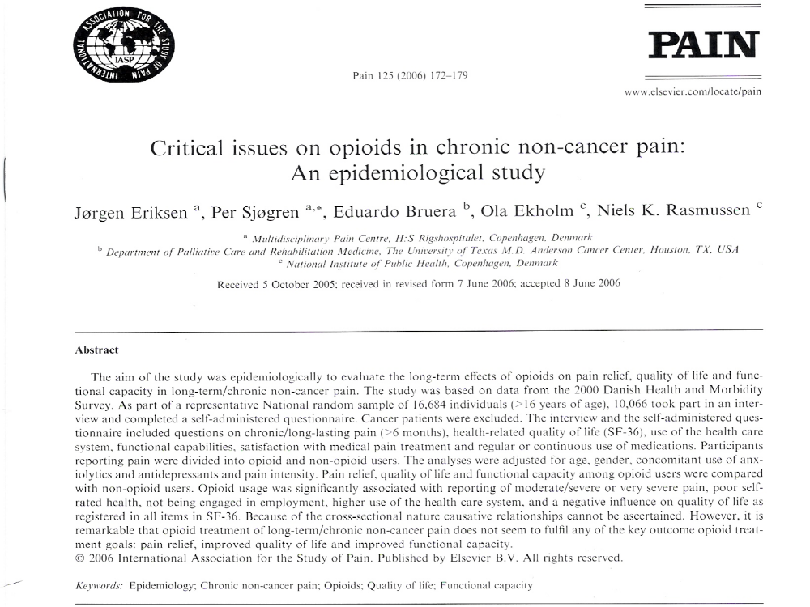

Slide 14
Conclusions from Danish Health and Morbidity Surveys
Long-term/regular opioid use in 4-5% of the Danish population was associated with reporting:
High pain intensity, low functional capacity and poor quality of life
Poor self-rated health and sleep
Enhanced smoking behavior
Lower odds of recovery from chronic pain
Higher risk of all-cause mortality
Higher risk of injuries and poisoning resulting in hospital admissions
Lack of/low sexual desire
Højsted and Sjøgren, Curr Opin Anaesthesiol 2007
Eriksen et al., Pain 2006; Sjøgren et al, Eur J Pain 2009; Ekholm et al, Eur J Pain 2009; Sjøgren et al., Clin J Pain 2010; Kurita et al., Pain 2012; Ekholm et al., Pain 2014; Birke et al., Eur J Pain 2017 ; Birke et al., Pain Med 2018.

Slide 15
Critical issues on opioids
Opioid treatment of chronic non-cancer pain did not seem to fulfil any of the key outcomes
recommended by international guidelines:
Pain relief
Improved quality of life
Improved functional capacity
Højsted and Sjøgren, Curr Opin Anaesthesiol 2007
Eriksen et al., Pain 2006; Manchikanti et al., Pain Physician 2012; Dowell et al. MMWR Recomm 2016

Slide 16
Addictive behaviors related to opioid use for chronic pain: a population-based study
Højsted et al., Pain 2013
Six potential addictive behaviors were identified:
  daily smoking
  high alcohol intake
  illicit drug use in the past year
  obesity
  long-term use of benzodiazepines
  long-term use of benzodiazepine-related drugs
At least 2 of the 6 addictive behaviors were observed in:
23 % of the long-term opioid users* with chronic pain
12 % of those with chronic pain not using opioids
9 % of individuals without chronic pain
Conclusion:
A strong association was demonstrated between long-term opioid use
and the clustering of addictive behaviors
*Long-term users: individuals who in the previous year have used at least one prescription/month for six months.

Slide 17
The role of benzodiazepines in opioid treatment of CNCP
Studies from Norway, the United States, and Denmark have consistently showed that
long-term opioid use is strongly associated with co‐medication of BZD
Additionally, strong association between high doses of opioid and high doses of concurrent
use of BZD has been demonstrated
Skurtveit et al., Pain Med 2010; Morasco et al., Pain 2010; Melbye et al., Acta Anaesthesiol Scand 2012; Fredheim et al., Pain 2013; Birke et al., Acta Anaesthesiol Scand 2016.

Slide 18
Other concepts and definitions surounding opioid addiction
  Psychological dependence
  Opioid abuse
  Opioid dependence
  Aberrant opioid behaviour
  Problematic opioid use
  Pharmaceutical opioid use disorder
  Chemical coping

Slide 19
Addiction - ICD - 10
A cluster of behavioral, cognitive and physiological phenomena, which may develop after repeated substance use and that typically include:
    A strong desire to take the drug
    Difficulties in controlling its use
    Persisting in its use despite harmful consequences
    A higher priority given to the drug use than to other activities and obligations
    Increased tolerance
    Sometimes a physical withdrawal state
Højsted and Sjøgren, Curr Opin Anaesthesiol 2007
WHO, 2003

Slide 20
Diagnostic and Statistical Manual for Mental Disorders, Fifth Edition (DSM-5)
  Taking larger amounts of opioids or taking opioids over a longer period than was intended
  Experiencing a persistent desire for the opioid or engaging in unsuccessful efforts to cut down or control it
  Spending a great deal of time in activities necessary to obtain, use, or recover from the effects of opioids
  Craving, or a strong desire or urge to use opioids
    (loss of control and carving)
    Using opioids in a fashion that results in a failure to fulfill obligations at work, school, or home
    Continuing to use opioids despite experiencing persistent or recurrent social or interpersonal problems caused or exacerbated by the effects of opioids
    Giving up or reducing important social, occupational, or recreational activities because of opioid use
    Continuing to use opioids in situations in which it is physically hazardous
    Continuing to use opioids despite knowledge of having persistent or recurrent physical or psychological problems that are likely to have been caused or exacerbated by the substance
      (social and interpersonal problems)
      Tolerance, as defined by either a need for markedly increased amounts of opioids to achieve intoxications or desired effect, or a markedly diminished effect with continued use of the same amount of an opioid
      Withdrawal, as manifested by either the characteristic opioid withdrawal syndrome, or taking opioids to relieve or avoid withdrawal symptoms
      Tolerance and withdrawal criteria are not considered to be met for individuals taking opioids solely under appropriate medical supervision
        (tolerance and withdrawal)
  American Psychiatric Association 2013

Slide 21
Addiction – Portenoy's criteria
  Addiction is a psychological and behavioural syndrome characterized by
  Evidence of psychological dependence
      (A) An intense desire for the drug and (B) overwhelming concern about its continued availability
  Evidence of compulsive drug use
      Unsanctioned dose escalation
      Continued dosing despite significant side effects
      Use of drug to treat symptoms not targeted by therapy
      Unapproved use during periods of no symptoms
  Evidence of other aberrant drug-related behaviours
      Manipulation of the treating physician or medical systems for the purpose of obtaining additional drugs (ex. altering prescriptions)
      Acquisitions of drugs from other medical or non-medical sources
      Drug-hoarding or sales
      Unapproved use of other drugs (sedatives, hypnotics) or alcohol
Portenoy, JPSM 1990

Slide 22

Prevalence of opioid addiction in a multidisciplinary pain centre
252 patients with chronic pain (235 non-cancer, 17 cancer) were screened for addiction ICD-10 and
Portenoy’s criteria (PC) by the treating physician and nurse and filled in the Pain Medication
Questionnaire (PMQ). 74% were treated with opioids.
Prevalence of addiction to opioids:
    ICD-10: 14.4%
    PC: 19.3%
Inter-rater agreement:
    ICD-10: 95%
    PC: 93%
PMQ (response rate 78%):
    PMQ had acceptable construct and criterion validity and high reliability
    Patients in the high-risk group used higher opioid doses, drank more alcohol, smoked more tobacco, used more benzodiazepines and displayed more anxiety and depression than those in the low risk group
Højsted et al., Eur J Pain 2010, Højsted et al., Acta Anaesth Scand 2011

Slide 23
Prevalence of opioid and medicinal cannabis addiction in two multidisciplinary pain centers
888 patients with chronic pain were screened for addiction using among other instruments DSM-IV and
PC. Response rate was 57%. Opioid treatment: 53.4%; MC-treatment: 37.3%; Mixed treatment: 8.7%.
Prevalence of addiction to opioids:
    DSM-IV: 52.6%
    PC: 17.3%
Prevalence of addiction to MC:
    DSM-IV: 21.2%
    PC: 10.6%
Problematic use of opioids and cannabis was more common in individuals using medications for longer
periods of time, reporting higher levels of depression and anxiety, and using alcohol or drugs.
Feingold et al., Pain Med 2017

Slide 24
Predicting the risk for aberrant opioid use behavior in patients receiving outpatient supportive care consultation at a comprehensive cancer center
751 opioid treated patients with cancer referred to supportive care were screened with SOAPP-14 and
CAGE-AID for aberrant drug behaviour (ADB). Response rate was 97%.
Prevalence of ADB :
    SOAPP-14: 19.6%
    CAGE-AID: 10.5%
Men and patients who have anxiety, financial distress, and a prior history of alcoholism/illicit drug use
are at increased risk of ADB.
Yennurajalingam et al., Cancer 2018

Slide 25
Tapering off opioids in chronic non-cancer pain (CNCP) and cancer patients
Studies | Design | Patients and treatments | Intervention | Assessments | Outcomes
Sullivan et al., J Pain 2017 | RCT | CNCP patients (N=35). Oral opioids. | CBT program plus 10% opioid dose reduction per week; however, pausing the taper was allowed. Control: Usual care. | Baseline and 22 and 34 weeks after randomization. Measures: Pain, abuse, health, anxiety, sleep and QoL | The intervention: Improved self-reported pain interference and decreased prescription opioid problems at 22 weeks.
Kurita et al., Eur J Pain 2018 | RCT | CNCP patients (N=75; N=35). Oral opioids. | Phase 1: Stabilization of opioid dose Phase 2: 10% opioid tapering of opioid dose every 1-2 weeks until discontinuation up to 6 months. Control: Stabilization opioid treatment | Phase 1: Months Measures: cognitive function, pain, sleep, rest, quality of life, depression, anxiety, opioid misuse and opioid withdrawal symptoms | Phase 1: Improved psychomotor function, sleep, opioid withdrawal symptoms, QoL and misuse scores. Phase 2: Improved sleep.
Arthur et al., The Oncologist 2018 | Controlled study | Cancer patients with aberrant opioid-related behavior (AB) (N=30) vs patients without AB (N=70). | The Compassionate High Alert Team (CHAT) | Observation period 3 months Measures: Number of ABs, opioid use, ESAS, Memorial Delirium Assessment Scale and CAGE-AID score. | The intervention: Reduced number of ABs and opioid use.
Notes:
25

Slide 26
Over-all conclusions and future directions
Substantial risks of addiction/problems in chronic pain patients treated with long-term opioids
Further development and validation of instruments to identify problematic opioid use
Use and implementation of guidelines for responsible opioid prescribing:
  Dowell et al. CDC guideline for prescribing opioids for chronic pain. JAMA 2016
  2017 Canadian Guideline for Opioids for Chronic Non-Cancer Pain. www.cfpc.ca/2017-canadian-opioid-prescribing-guideline
  The Norwegian Directorate of Health. National recommendation for opioid treatment for chronic non-cancer pain [Internet]. [cited 2016 Sep 1]. Available from: https://helsedirektoratet.no/retningslinjer/opioider
  National klinisk retningslinje for opioidbehandling af kroniske non-maligne smerter. Sundhedsstyrelsen, december 2018.
More research in opioid addiction in cancer: Curatively intended therapy, palliative care and cancer survivors
Notes:
26

Slide 27

Reflections on pain management with opioids
    A pandemic lack of availability and accessibility of opioids for patients with advanced cancer!
    Those CNCP patients who benefits from long-term opioid treatment!
    Opiophobia and regulatory restrictions contribute to undue suffering for millions!
    Too liberal use of opioids cause harm to millions!
Carmona-Bayonas et al., Clin Transl Oncol 2017

Slide 28
A research agenda
    Projects:
    The association between long-term opioid use, morbidity, mortality, life style behavior and use of health care services in a Danish population
      Cohorts of CNCP patients from 2010 and 2013
      Postoperative initiation/maintenance of long-term opioid use
      Prescriptions of analgesics to long-term survivors of childhood cancers
    2) Iatrogenic opioid addiction in patients with cancer and non-cancer chronic pain
      Prevalence of opioid addiction by the PMQ among opioid treated patients with CNCP and cancer-related pain
      Associations between genetic variations and addiction risk
      Test an opioid taper off program in a pilot group
    3) The immune and endocrine systems in CNCP pain patients treated with long-term opioids: effects on
    cognition, pain and QoL
      Explorative comparison study
Notes:
28

